Slide 1
Native Database Encryption
By
Sarin Ravishanker

Slide 2
What is Encryption?
A process that converts original information, also called plain text into a difficult-to-interpret form called ciphertext.
Done by using an encryption algorithm, a formula used to turn plain text into ciphertext.
Two types: Symmetric and Asymmetric

Slide 3
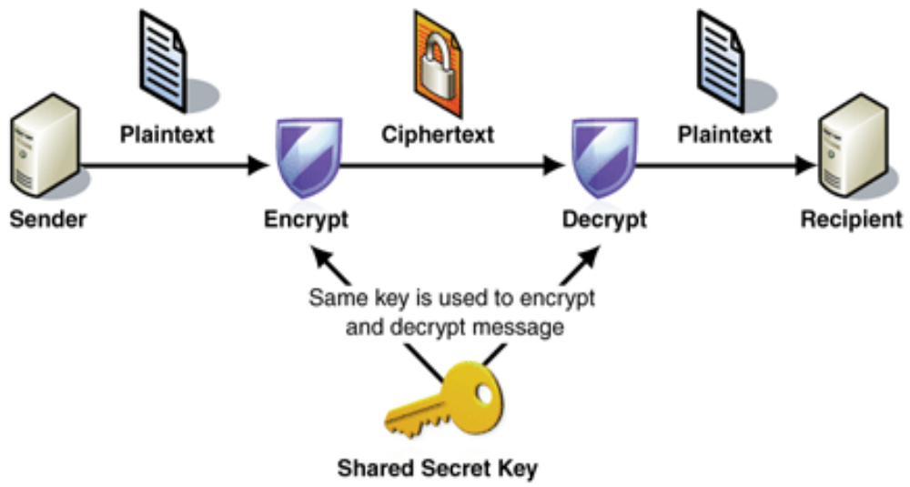
Symmetric Encryption

Slide 4

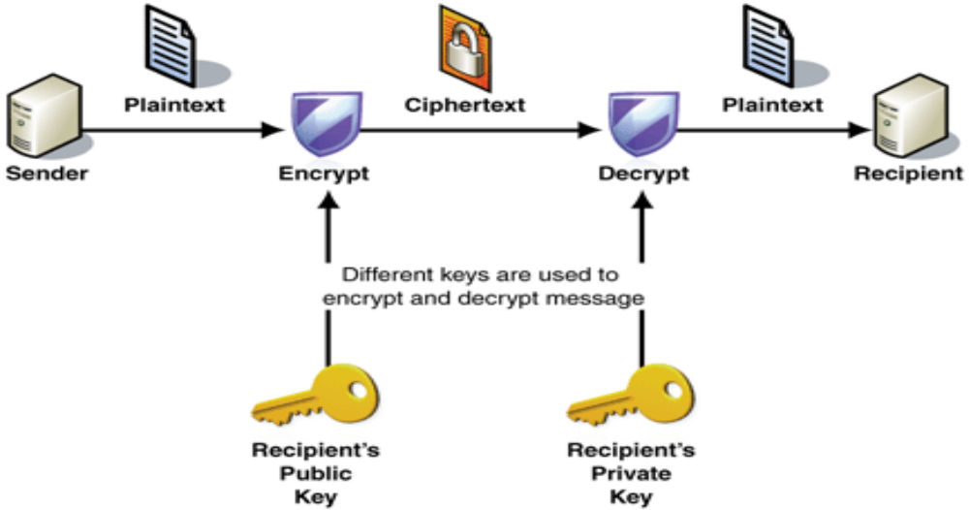
Asymmetric Encryption

Slide 5
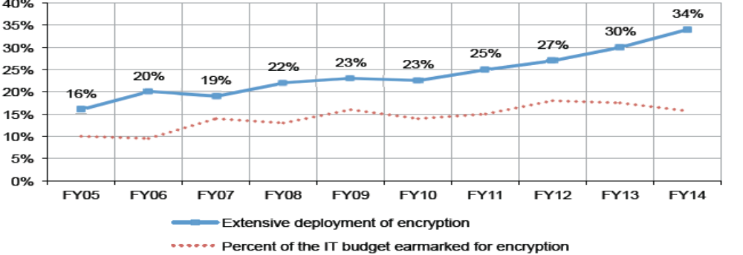
Encryption in IT
According to Ponemon Institute study (2015) :
Trends in Adoption of Encryption

Slide 6
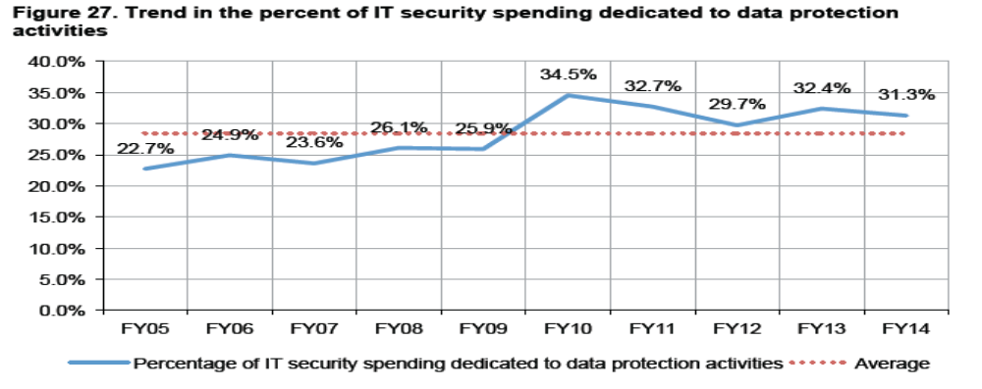
Encryption in IT
Budget Allocated to Data Protection

Slide 7
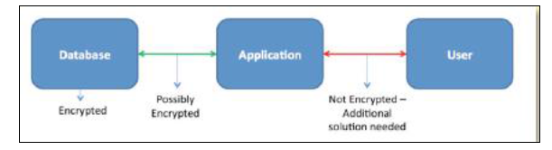
Pre-Requisites
Factors to consider before implementing Encryption:
Level of Encryption – Application level, File/disk level, Database level
Encryption Algorithm
Access to keys – Key management
Performance impact after encryption

Slide 8
Native Encryption
Microsoft SQL Server – Transparent Data
Encryption (TDE)
Oracle – Transparent Data Encryption (TDE)

Slide 9
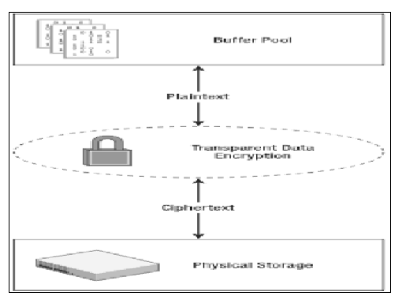
TDE in MS SQL Server
Introduced in SQL Server 2008 edition onwards
Supports Full database encryption

Slide 10
TDE in MS SQL Server
Steps to Implement TDE:
Create Database Master Key (DMK) in the master database
Create server certificate in the master database
Take a back up of the certificate in a secure facility
Create Database Encryption Key (Only one DEK per user database)
Enable Encryption on the user database

Slide 11
TDE in MS SQL Server
Advantages
MS SQL Server TDE implementation to encrypt the entire database is easy
TDE automatically encrypts tempdb and database transaction logs to prevent data leakage
Since TDE decrypts data in the buffer pool, improves query performance.
Disadvantages
Available only in Enterprise , Developer and Datacenter Editions
The data is not protected from authenticated users like DBA
Compressing an Encrypted back-up takes more time and space

Slide 12
TDE in Oracle
Introduced in Oracle 10g and 11g edition onwards with Advanced Security Option
Two Types of TDE:
TDE Column Encryption
TDE Tablespace Encryption

Slide 13
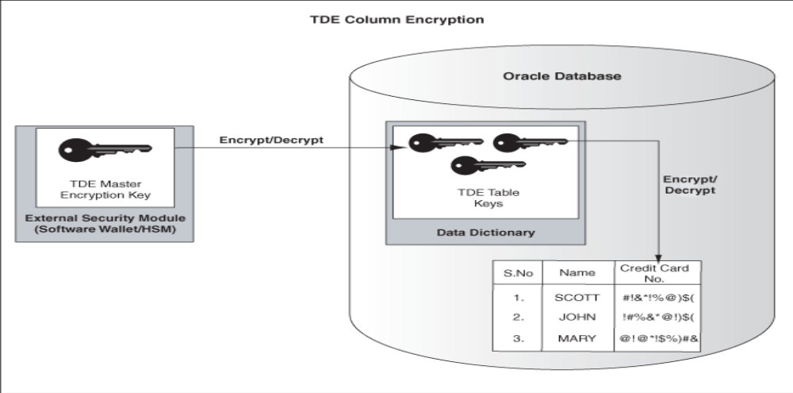
TDE in Oracle
TDE Column Encryption

Slide 14
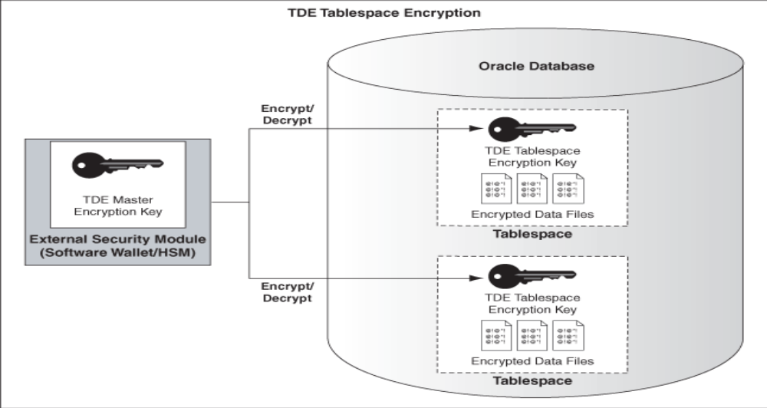
TDE in Oracle
TDE TableSpace Encryption

Slide 15
TDE in Oracle
Steps to Implement TDE:
Create an Oracle Wallet to store master encryption key
Identify tablespace or column data to be encrypted
Create encrypted tablespace or column

Slide 16
TDE in Oracle
Advantages
TDE implementation is easier on Oracle databases
Database columns and tablespaces are automatically encrypted before it is written to disk.
Encryption is completely transparent to the application
Disadvantages
The data is not protected from authenticated, authorized database users, including the DBA.
TDE tablespace encryption does not encrypt data that is stored outside the tablespace
Performance of database is hit; inserts/updates on encrypted data are slower

Slide 17
Questions???

